Slide 1
Computer Science 1
Boolean and If statements in Python

Slide 2
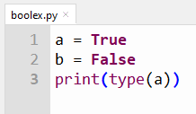

Boolean values
In Python the values True and False are special types called bool – short for boolean named after mathematician George Boole
Output:

Slide 3
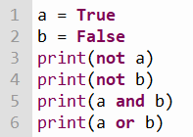


Boolean Operators
Not – changes True to False and vice-versa
And – evaluates to True if both operands are True
Or – evaluates to True if either operands are True

Slide 4
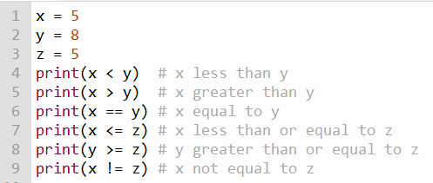
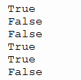
Relational Expressions
Relational Expressions evaluate to bool values True and False

Slide 5
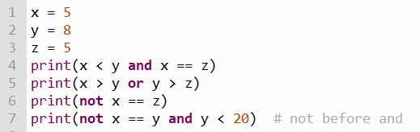

Relational Expressions
We can combine relational operators with boolean operators

Slide 6
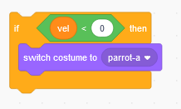

If statements
Scratch
Python
Code to run is indented 4 spaces.
Code to run if vel < 0 is inside the orange block.

Slide 7
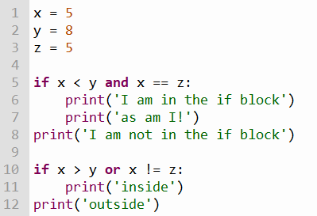


If Statements Syntax
Thonny will automatically indent after the :
When done putting code in the if block, use shift-tab to dedent back

Slide 8
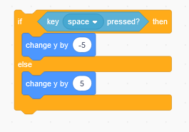
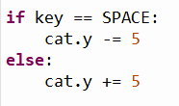
If – Else statements
Scratch
Python

Slide 9
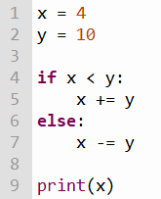
If-Else Syntax

Slide 10
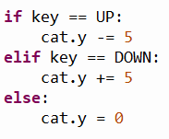
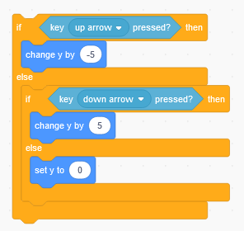
If – Elif - Else statements
Scratch
Python
(These statements are not easily done in Scratch)
elif means “else if”

Slide 11
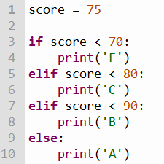
If-Elif-Else Syntax
score is less than 80 so print C
Because a previous “branch” was executed, even though score is less than 90, this block will not run!

